Slide 1
Lab1 - ns3
Advisor : Hsi-Lu Chao
TAs : Zheng-Feng Li
Tien-Wen Chang
Chun-Sheng Chen
2023.10.13

Slide 2
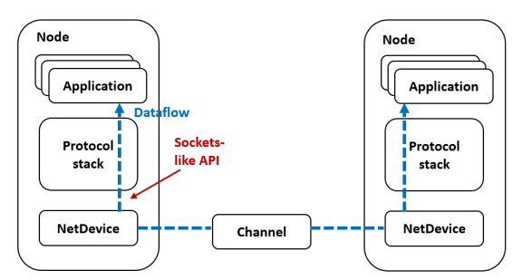
Introduction - ns3
NS-3 is free and open source discrete event network simulator.
Users can write in c++
Support different network layers
Applications: On/Off, Bulk transfer, HTTP, etc.
Transport: TCP, UDP
Network: IPv4, IPv6, routing
Physical: Ethernet, wifi, LTE, etc

Slide 3
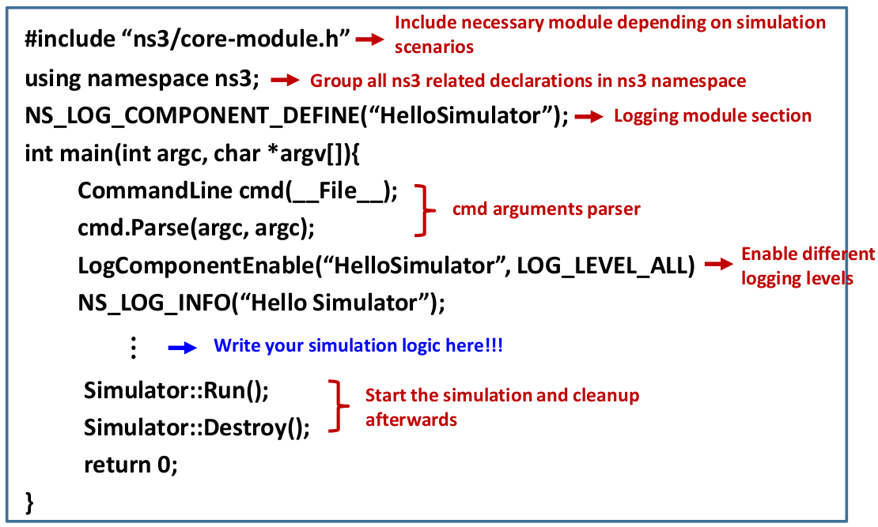
Introduction - Start
Basic Structure

Slide 4
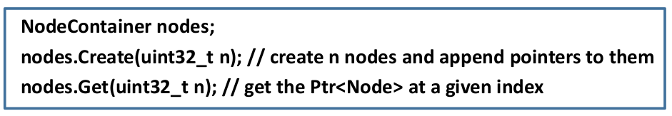
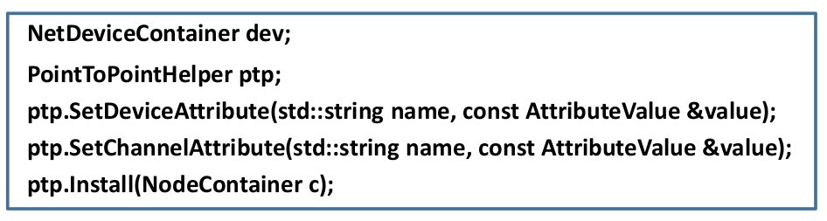
Introduction - Structure
Create Nodes
Construct point to point flow & install netDevice
DataRate
Delay

Slide 5
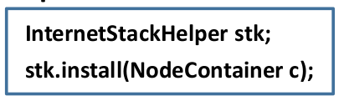
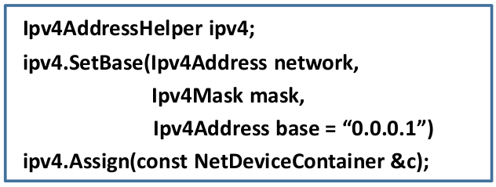
Introduction - Structure
Install protocal stack
Assign IP address

Slide 6
Introduction - Structure
Create Server Application and Install
UdpEchoServerHelper server (9);
ApplicationContainer serverApps = echoServer.Install (nodes.Get (xxx));
server.Start (Seconds (1.0));
server.Stop (Seconds (10.0));
Create Client Application and Install
UdpEchoClientHelper echoClient (interfacesBC.GetAddress (xxx), 9); // create application on node xxx
echoClient.SetAttribute ("MaxPackets", UintegerValue (1));
echoClient.SetAttribute ("Interval", TimeValue (Seconds (1.0)));
echoClient.SetAttribute ("PacketSize", UintegerValue (xxx));
ApplicationContainer clientApps = echoClient.Install (nodes.Get (xxx)); // install application on node xxx
clientApps.Start (Seconds (2.0));
clientApps.Stop (Seconds (10.0));

Slide 7
Introduction – Get Throughput
Get Throughput and compute jain's fairness index
DataRateValue dataratevalue;
netDevice.Get(xxx)->GetAttribute("xxx", dataratevalue);
DataRate dataRate = dataratevalue.Get();
// convert to Mbps
double throughputAB = dataRate.GetBitRate() / 1e6;

Slide 8
Lab - Requirements
Topology : Construct Three Node (A, B, C)
Two Clients Node (A & B)
One Server Node (C)
Flow generation : create two flows
Flow 1
Sender : A ; receiver : B
Traffic pattern :
data Size is 5 Mbps
delay is 10 ms
Flow 2
Sender : B ; receiver : C
Traffic pattern :
data Size is 10 Mbps
delay is 20 ms

Slide 9
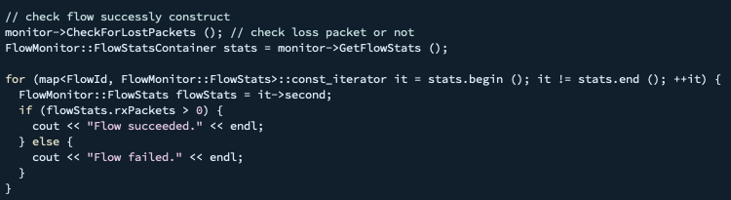
Lab - Requirements
Output each flow's throughput
Compute the Jain's fairness index with each throughput
You do not modify the below code. It will used to check your flow is construct successfully or not !!

Slide 10
Lab - Requirements
Score
Environmetn Setting : 10 %
To Do (1) : 10 %
To Do (2) : 30 %
To Do (3) : 30 % (Throughput 20 % & Jain's fairness index 10 %)
Report : 10 %
Spec
Lookup 20232_wnlab_lab1.pptx from E3 Assignment Lab1
Submission
File name
{Student_id}_{Student_name}_Lab2.zip
Contained
Source Code
Lab1_original.cc.py
lab1.pdf
Implementation of code (ex: how to implement)
Screen shot of your result (ex: throughput and jain's fairness index)
Anything you want to share

